Slide 1
NEW COMPUTING IDS
Beginning in fall 2021, new students, faculty and staff have an email ID that does not match their initials.
This change was done intentionally, after many years of complaints from students, faculty and staff who did not want their initials (or old initials) to be part of their computing ID.
Reasons
Safety (Stalking Cases)
Marriage/Divorce
Name Changes for Other Reasons

Slide 2
This has made finding a student close to impossible.
For example, Jane Marie Smith writes and her email address used to be jms5qp.
One could search and even with all the Jane Smiths that came up, there was likely only one or two with the middle name Marie.
Now Jane’s email is xzw5tdb.

Slide 3
Modifying SIS to be able to allow a search by computing ID is not possible right now so ITS added the SIS ID to our eAdvising tool.
This was, on short notice, the best solution we had.
How does it work?

Slide 4
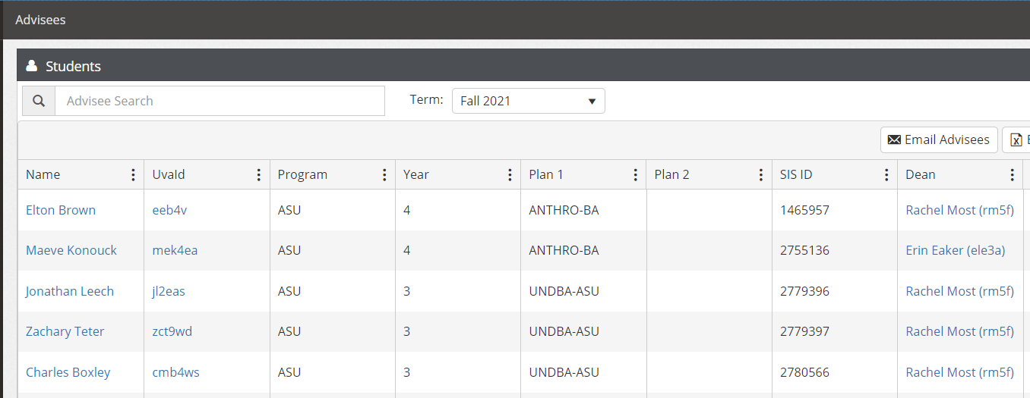
When you log in, the default view is to your advisees.

Slide 5
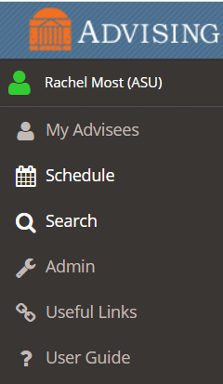
If you need to find the ID of a student who is not your advisee, click on SEARCH on the left-hand side of the screen.

Slide 6
Be sure to UNCHECK the box that reads “Only show my advisees”.

Slide 7
Enter the Last Name or the Computing ID and click FILTER

Slide 8
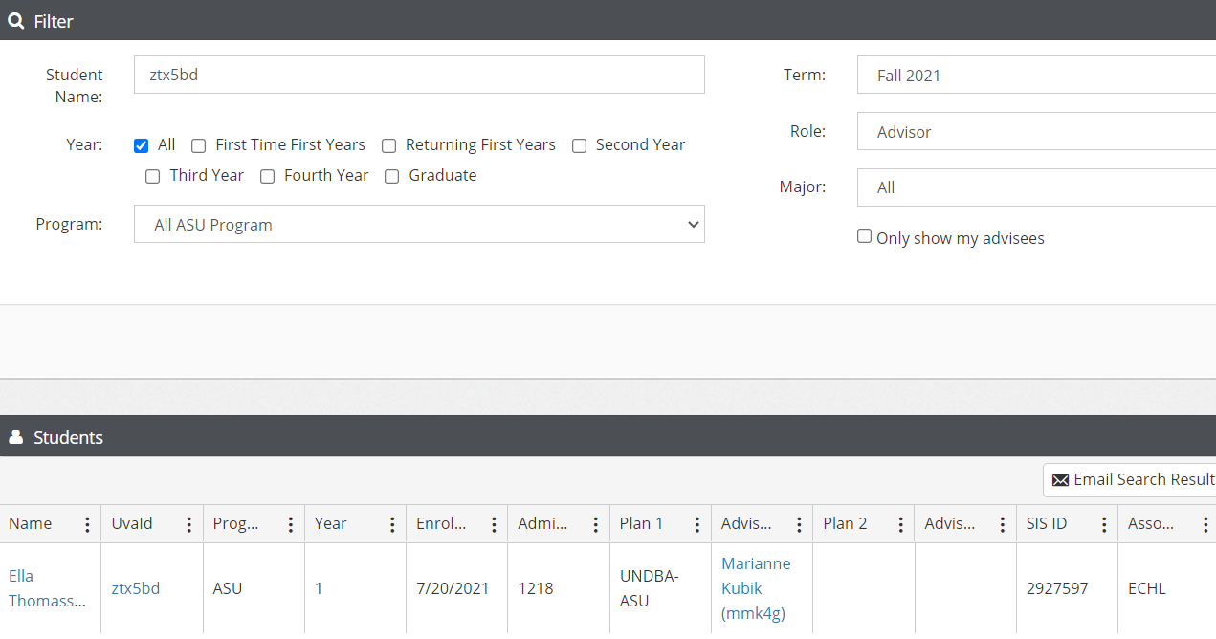
Note that you can now hide columns if there are data/columns you do not want to see.

